Slide 1

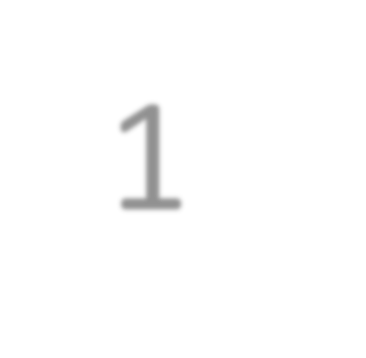

Capstone Project - 1
EDA on Play Store App Reviews
Rohit Meshram

Slide 2


Content :
Introduction
Problem Statement
Dataset Description
Data Processing
Import Libraries
Cleaning Data
Correlation Heatmap
Categorical Analysis
Distribution of app ratings
Paid app in each category
Analysis of user reviews
Positive and Negative review
Most Review Apps
Challenges faced
Conclusion

Slide 3

Introduction
The Google Play Store and formerly Android Market, is a digital distribution service operated and developed by google. It serves as the official app store for certified devices running on
the android operating system and its derivatives as well as ChromeOS, allowing users to browse and download application.
The play store data has enormous potential to drive app-making businesses to success. Actionable insights can be drawn for developers to work on and capture the Android market.
Taking into account billion of android users worldwide, mining this data has the potential to reveal user behaviours and trends in the whole global scope. This dataset is obtained from scraping Google Play Store.

Slide 4
Problem Statement
Two datasets are provided, one with basic information and the other with user reviews for the respective app.
We must examine and evaluate the data in both datasets in order to identify
the important characteristics that influence app engagement and success.
So, what factors influence an app’s success?
An app is said to be successful if it has :
A high average user rating
A good number of positive reviews
A good numbers of monthly average users
High revenue per customer and so on.

Slide 5
Dataset Description
Two different datasets provided for analysis:
1. Play Store Data.csv
App :Categorical, the app names.
Category Rating Reviews Size Installs Type Price
Content Rating Genre
Last update
:Categorical, category the app belongs to.
:Numerical, range from 0.0 to 5.0, rating has received from the users.
:Numerical, the number of reviews that the app recived.
:Numerical, the size of the app. The suffix M- megabytes, K - kilobytes.
:Numerical, describes the number of installs.
:Categorical, a label that indicates weather the app is free or paid.
:Numerical, the price value for the paid apps.
: Categorical, a categorical rating that indicates the ages group for user.
:Categorical, a categorical rating that indicates the age group for user.
: Date format, the date at which the app was last updated.

Slide 6
2.User Review.csv
App
Translated_Review
Sentiment
Sentiment_polarity
:The app name.
:The review text in English
:The sentiment of the review, positive, neutral, or negative.
:The sentiment in numerical form,ranging from-1.00 to1.00.
Sentiment_subjectivity : a measure of the expression of opinions, evalutions,
feelings, and speculations.

Slide 7
Data Processing
Discussion of Google play store dataset will involve various steps such as:
loading the data into data frame
cleaning the data
extracting statistics from the dataset
exploratory analysis and visualizations
questions that can be asked from the dataset

Slide 8


















































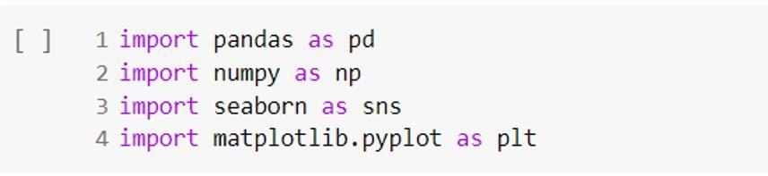
Import Libraries
Library is a collection of related modules. It contains bundles of code that can be used repeatedly in different programs. It makes python programming simpler and convenient for the programmer.
Importing Requrie Libraries

Slide 9
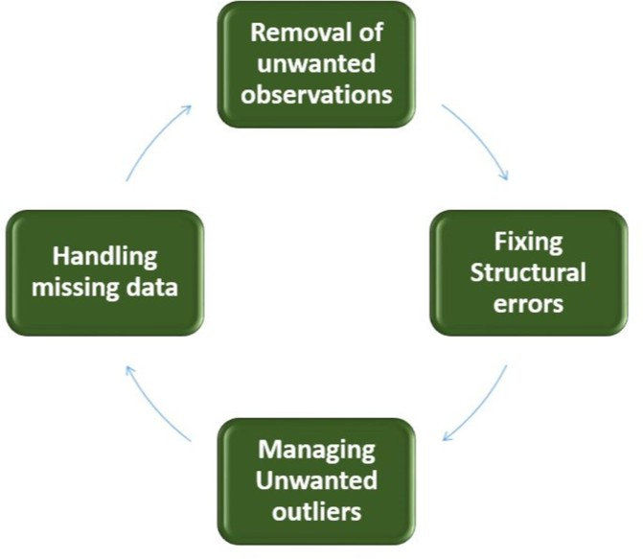
Cleaning data
Cleanse and validate data
This step is crucial for removing faulty data and filling gaps. Important tasks here includes:
Removing extraneous data
Filling in missing values.
Conforming data to a standardized pattern.
Dataset may contain duplicate values for particular application.

Slide 10
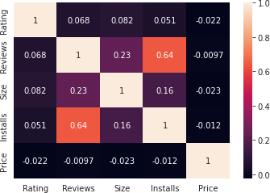
Correlation Heatmap
There is a strong positive correlation between the Review and Installs
The price is slightly negatively corrected with the Rating , Review, and Installs.
The rating is slightly positively correlation with the Installs and Reviews.

Slide 11
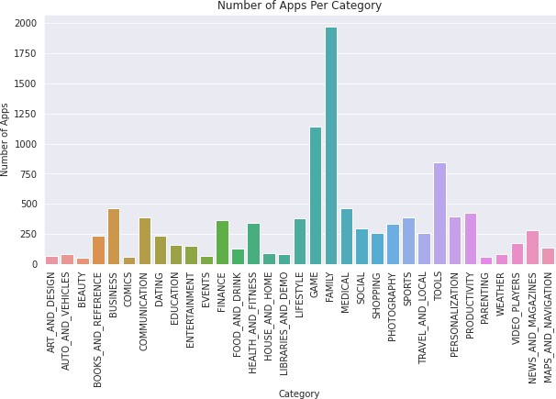
Categorical Analysis
The Family, Game, and Tools category has the highest number of apps.

Slide 12
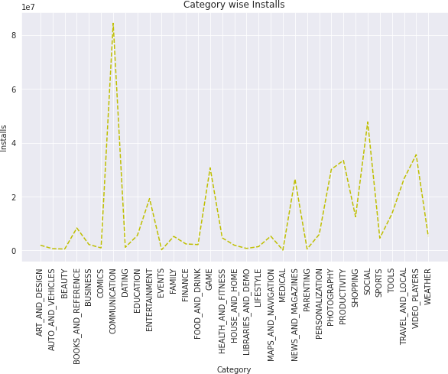
Categorical Analysis
The Communication, Video players, and Social category has highest number of app installs.

Slide 13
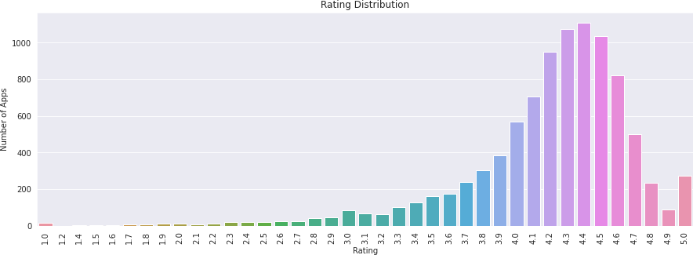
Distribution of app ratings
Scale is from 1 to 5
Most of the apps, clearly hold a rating of 4.4
This implies that the majority of the users are happy with the service received via the respective app.

Slide 14
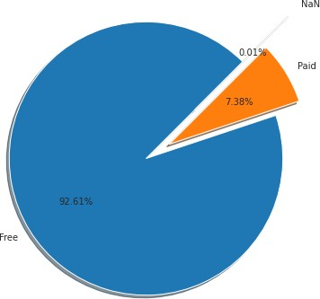
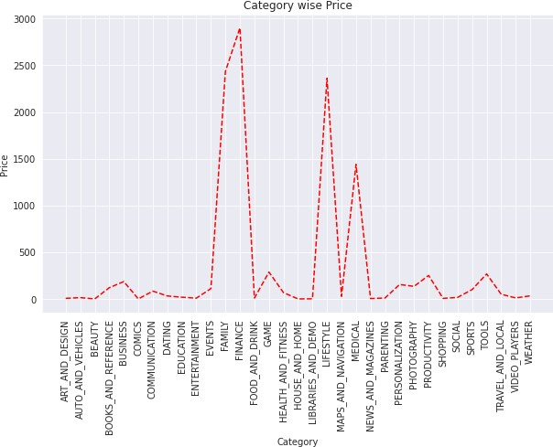
Paid app in each category
It looks like certain app categories have more free apps available for download than others
The paid apps in the finance, Lifestyle, and Event category are on average significantly more expensive than paid apps in other categories.

Slide 15
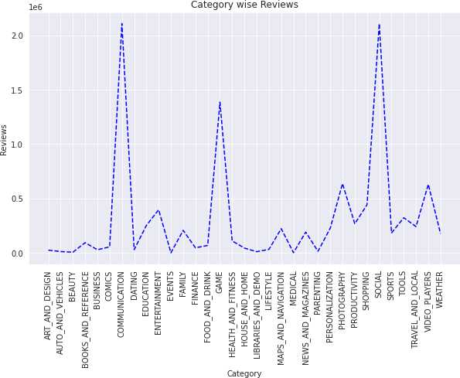
Analysis of user reviews
Apps related to communication ,Games and Social seem to have highest number of reviews.

Slide 16
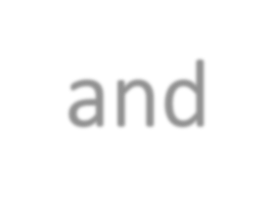
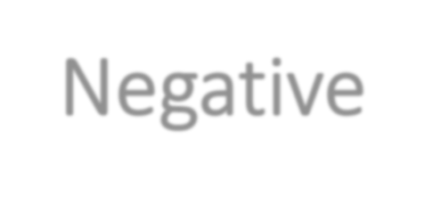
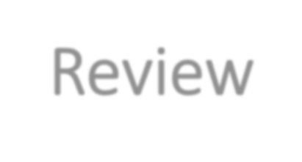

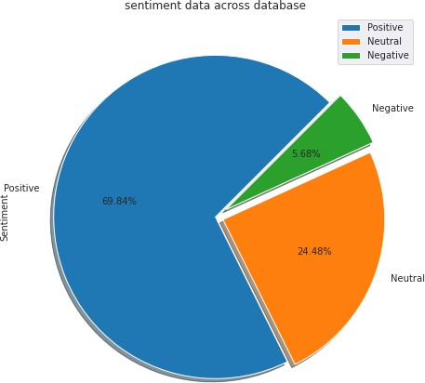
Positive and Negative Review
The percentage of positive reviews of the apps in the play store is much greater than the negative and neutral reviews which are 69.84%.
Negative percentage of apps are 5.68%
Neutral percentage of apps are 24.48%

Slide 17
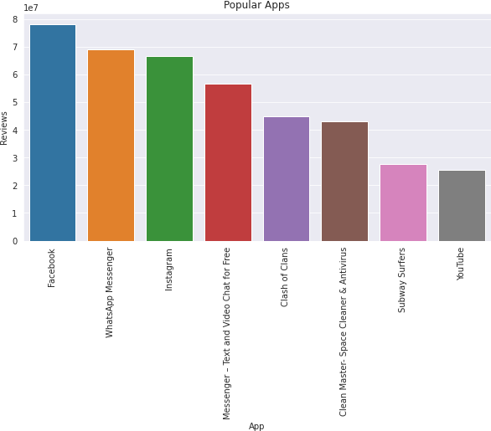
Most Review Apps
This are some most review apps in the play store. We can state that the apps with more review, whether positive, negative, or neutral, are more popular than the other.
This is because the number of user reviews indicates that these individuals have engaged with the app’s content and have written their opinion on it.

Slide 18
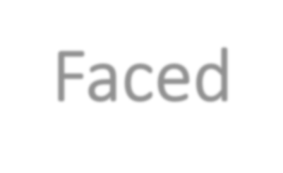

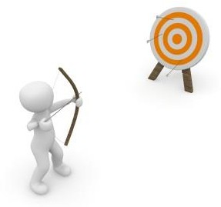
Challenges Faced
Reading the dataset and comprehending the problem statement.
Examining the business KpIs for app development and devising a solution
to the problem.
Handling the error, duplicate and NaN values in the dataset.
Designing multiple visualization to summarize the information in the
dataset and successfully communicate the result and trends to the reader.

Slide 19
Conclusion:
In this project of play store app review analysis we've drawn many intresting inferences and some great results, here's a conclusion of few of them:
Maximum number of apps belongs to the family category and gaming category.
Most of the apps are free very few apps are paid apps in which family category has the most free and paid apps and social apps like entertainment are almost free.
The rating is very high with at least 75% of the apps in the range 4.0 to 4.7.
Among all rating of events apps is highest whereas dating apps has lowest rating.
Communication and social category apps has high reviews.
Mostly downloaded apps are communication apps.
Most of the paid apps belongs to finance category.
There are more number of positive reviews of apps in which facebook, whatsapp, Instagram are the most review apps

